Slide 1
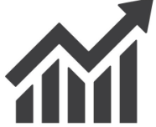
FCMG BREWERIES SALES PERFORMANCE ANALYSIS REPORT
UNLOCKING INSIGHTS TO DRIVE GROWTH

Slide 2
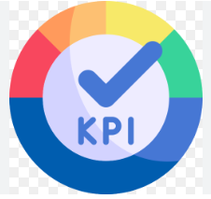
Summary Of The Report's KPI’S
TOTAL SALES
241.9M
TOTAL PROFIT
105.6M
PROFIT MARGIN
43.7
TOTAL ORDERS
1047
TOTAL QUANTITY
891K
BEST PERFORMING BRAND
BUDWEISER

Slide 3
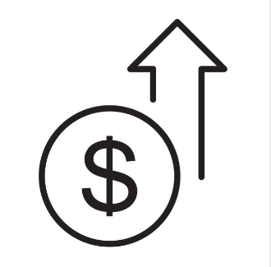
SALES PERFORMANCE

Slide 4

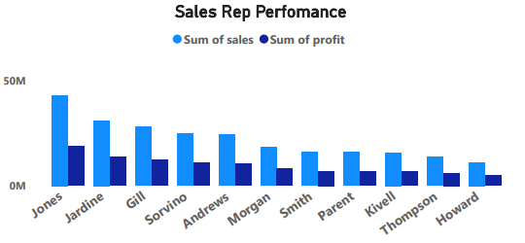
Total Sales Revenue by Representative
Total sales revenue of $243.4M was generated by 11 sales representatives.
Total sales revenue by representative:
- Jones: 42,968,100
- Jardine: 30,988,250
- Gill: 27,869,550
Profit Analysis: Jones achieved highest profit (18,770,830) due to high sales revenue, effective cost management and strong customer relationships.

Slide 5
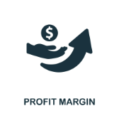
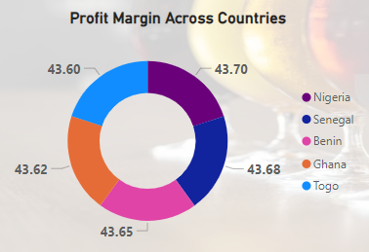
PROFIT MARGIN ACROSS COUNTRIES
SENEGAL ; 43.676276 (43.67%)
NIGERIA ; 43.6973311 (43.70%)
GHANA ; 43.6240489 (43.62%)
BENIN ; 43.6510369 (43.65%)
TOGO ; 43.6020949 (43.60%)

Slide 6
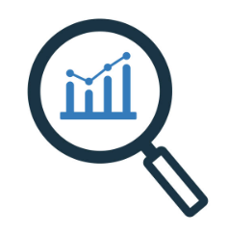

MARKET INSIGHTS

Slide 7
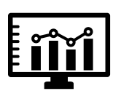
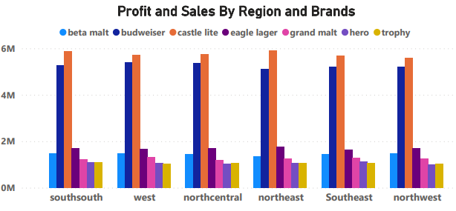
Regional Sales Performance
Southsouth has highest total sales of 40,756,500, and the highest profit of about 17,768,90, with the least profit and sales coming from Northwest.

Slide 8
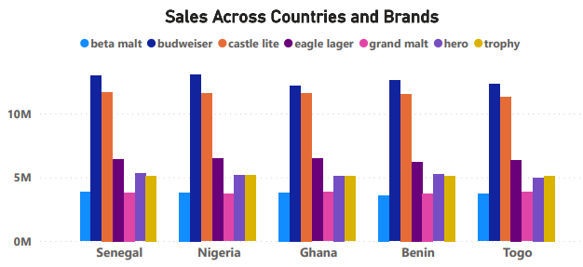
Top-Selling Products by Country
Budweiser, Castle Lite and Eagle Lager are top-selling products in each country.

Slide 9

STRATEGIC INSIGHTS

Slide 10
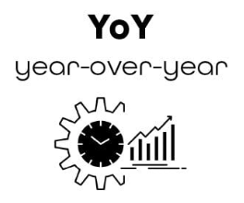
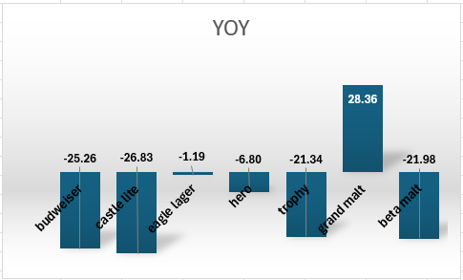
YEAR-OVER-YEAR-GROWTH
Budweiser and Castle Lite experienced significant decline (-25.26% and -26.83%).

Slide 11
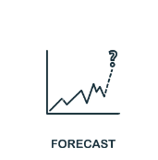
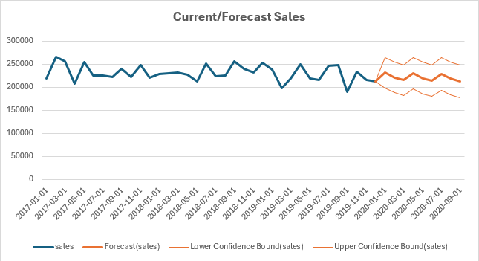
SALES FORECAST
JANUARY 2020 231818.1536
FEBRUARY 2020 221011.9989
MARCH 2020 215542.2781
APRIL 2020 230553.1152
MAY 2020 219746.9605
JUNE 2020 214277.2397
JULY 2020 229288.0767
AUGUST 2020 218481.9221
SEPTEMBER 213012.2012

Slide 12

CUSTOMER INSIGHT

Slide 13

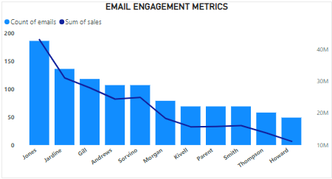
Email Engagement Metrics
Email Marketing Effectiveness: Positive correlation between emails sent and sales generated.

Slide 14

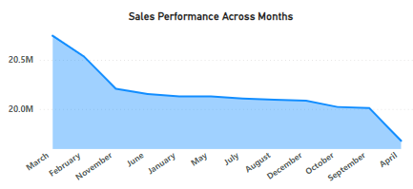
Seasonal Sales Patterns
More sales are made in March and February, with April having the least sales

Slide 15

RECOMMENDATIONS
RECOMMENDATIONS
Focus on high-performing regions and brands.
Optimize product mix for maximum profitability.
Develop targeted customer retention strategies.
Enhance email marketing effectiveness.
Invest in regional marketing efforts.
Monitor sales trends for informed forecasting.
ACTION ITEMS
Review sales data by representative and region.
Analyze profit margins and cost control measures.
Develop strategic plans for growth opportunities.

Slide 16
RECOMMENDATIONS
Brand-Wise Recommendations
1. Budweiser: Maintain market share across regions.
2. Castle Lite: Increase sales in Ghana, Nigeria, and Senegal.
3. Eagle Lager: Boost sales in Ghana, Nigeria, and Togo.
4. Grand Malt: Grow presence in Ghana, Senegal, and Togo.
5. Hero: Maintain presence across regions.
6. Trophy: Optimize distribution across regions.
7. Beta Malt: Reduce presence in all regions.

Slide 17

CONCLUSION
Sales Performance
1. Total Sales: $241,892,650.
2. Highest Sales: Senegal ($49,191,900).
3. Top Sales Representative: Jones ($42,968,100).
4. Monthly Sales Trend: Peaks in March and February, dips in April and September.
5. Sales Trend: Sales declined from 2017 to 2019.
Profit Analysis
1. Total Profit: $105,587,420.
2. Highest Profit: Jones ($18,770,830).
3. Profit Margin: Average 43.7% (varies by region and product).
4. Year-over-Year Growth: Budweiser and Castle Lite show significant decline (-25.26% and -26.83%).
Product Performance
Best-Selling Product: Budweiser ($63,137,000).
Year-over-Year Growth: Grand Malt shows significant growth (28.36%).
Email Marketing Effectiveness: Correlation between emails sent and sales generated.
Repeat Purchases: Average 35 repeat purchases per region.

